Slide 1

Unity 3D Essentials
Game User Interface
SoftUni Team
Technical trainers
Software University
https://softuni.org

Slide 2
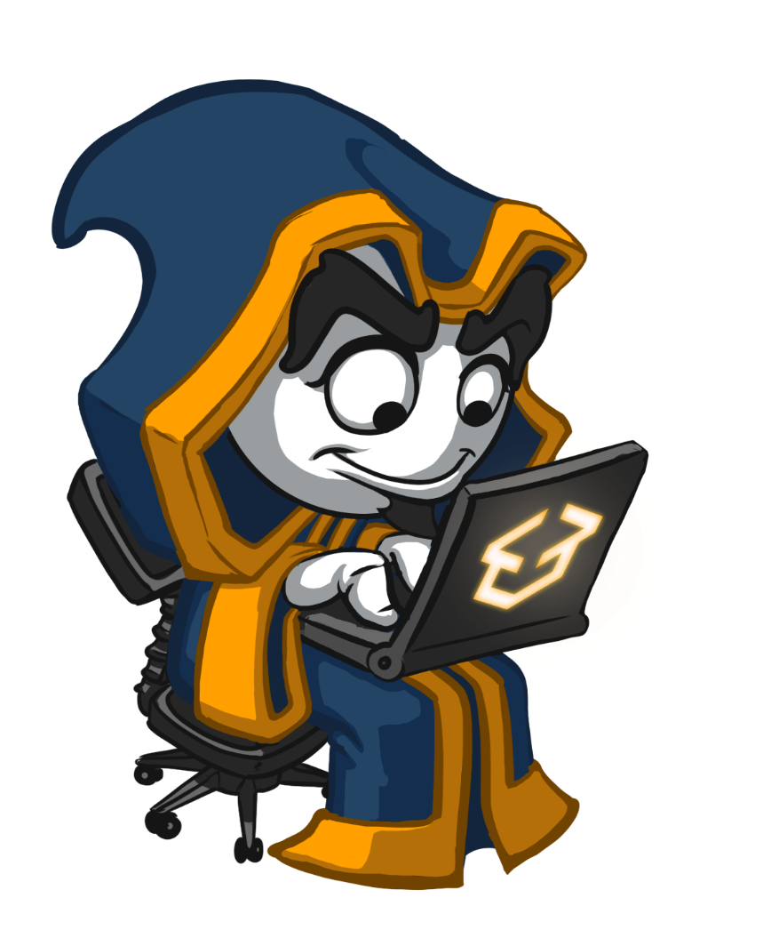
Table of Contents
UI Basic Components
UI Most Used Controls
UI Helpers to Shape the Layout
Useful Links

Slide 3
Have a Question?
sli.do
#Unity-3D
Notes:
‹#›

Slide 4

UI Basic Components

Slide 5
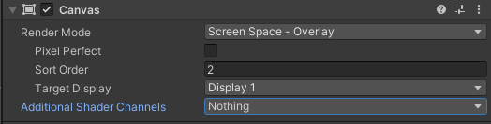
Canvas
Render Mode
Pixel perfect
Sort Order
Target Display
Additional Shader Channels

Slide 6
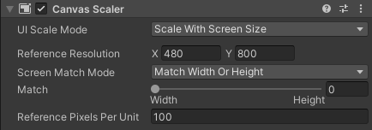
Canvas Scaler
Dictates how the canvas acts in different resolutions
Scale Modes
Reference Resolution
Match Modes
Pixel per unit

Slide 7
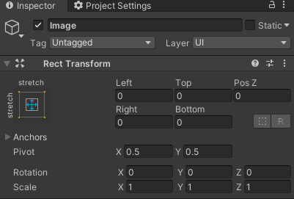
Rect Transform
Manipulation Tool
Anchors
Position
Pivot

Slide 8
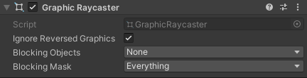
Graphic Raycaster
Clicking is done via raycast logic
Ignore reversed graphics
Blocking objects
Blocking mask

Slide 9

Most Used Components

Slide 10
Most used UI components
UI Image
Imported sprite (2D). Supports slicing
UI Button
Combination of Image & OnClick detection
UI Text
UI Slider
Draggable UI Image with limits
UI Scroll Rect
Supports inertia & other effects
Vertical and/or horizontal
Can be dynamically filled

Slide 11
Most used UI components
UI Mask
Hide children based on the passed picture
Raw Image
Like UI Image, but simpler and lighter
Input Field
Clickable UI Text with input box
Check Box
Clickable Image with flag for on/off state
UI Events & Triggers
Up/Down/Click & other detection components

Slide 12
UI Helpers

Slide 13
Common UI Helpers
Vertical Layout Group
Auto order vertically all children
Control order params
Horizontal Layout Groups
Auto order horizontally all children
Control order params
Layout Element
Override control from parent

Slide 14
Common UI Helpers
Content Size Fitter
Children controls overall size
Grid
Same as Vertical/Horizontal layout group
Orders in grid form
Aspect Ratio fitter
Lock the UI item according to its ratio no matter what
Canvas Group
Parent canvas dictating alpha

Slide 15

Lab

Slide 16
Add a UI Button that will:
Add a game "Start menu".
Add a UI slider to indicate the car's integrity.
Add a UI text to track the current score.
Add a UI image and use it for the "game over" splash screen.

Slide 17
Useful Links
https://learn.unity.com/tutorial/11-user-interface
https://docs.unity3d.com/2020.1/Documentation/Manual/UICanvas.html
https://docs.unity3d.com/2020.1/Documentation/Manual/UIBasicLayout.html
https://docs.unity3d.com/Packages/com.unity.ugui@1.0/manual/EventSystem.html

Slide 18

Summary
UI Basic Components
UI Most Used Methods
UI Helpers
Useful links
Notes:
‹#›

Slide 19
Questions?
Email : dstrashilov@gmail.com
Notes:
‹#›

Slide 20











SoftUni Diamond Partners
‹#›
Notes:
‹#›

Slide 21



Educational Partners
‹#›
Notes:
‹#›

Slide 22

License
This course (slides, examples, demos, exercises, homework, documents, videos and other assets) is copyrighted content
Unauthorized copy, reproduction or use is illegal
© SoftUni – https://about.softuni.bg
© Software University – https://softuni.bg
Notes:
‹#›

Slide 23
Trainings @ Software University (SoftUni)
Software University – High-Quality Education, Profession and Job for Software Developers
about.softuni.bg, softuni.org
Software University Foundation
softuni.foundation
Software University @ Facebook
facebook.com/SoftwareUniversity
Software University Forums
forum.softuni.bg
Notes:
‹#›

